Slide 1
National Technical Seminar
IPWE (India)
Use of Modern Retrofitting Techniques
in Udaipur Station Building
of Agartala – Sabroom New Line Project.
Presented by-
B.N. Bhaskar, Dy.CE/Const.-1/Agartala,
N. F. Railway (Construction)

Slide 2
LIST OF CONTENTS
INTRODUCTION.
HISTORY OF PROBLEMS.
remedial measures.
STRATEGY FOR RETROFITTING.
METHODOLOGY OF RETROFITTING.
CONCLUSIONS.

Slide 3
INTRODUCTION
Udaipur railway station of Agartala-Sabroom New BG Line Project is situated between Km. 42.2 to 43.3 (Km. 0.00 at Agartala) in the state of Tripura.
Station is situated in the Sukhsagar Lake of Udaipur.
Water logged and marshy soil.
Existence of soft soil (Silty Clay) upto 13.3m depth.
Out of 13.3m top 8m is mixed with decomposed trees & wooden logs.
During construction of building differential settlement of piles.
Retrofitting of the building was done and now the building is functional.
Agartala – Udaipur section was opened on 28.09.2016.

Slide 4
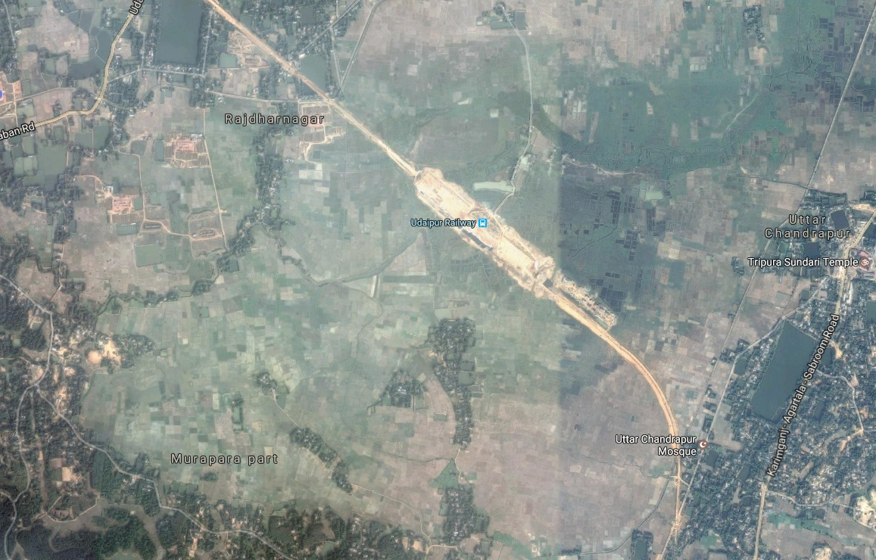
Location of Udaipur Station Building
Sukhsagar Lake
Udaipur Station

Slide 5
HISTORY OF THE PROBLEM
FORMATION IN STATION YARD:
Construction started in Dec’ 2010.
Huge Settlement in the range of 1 to 2m was noticed in Oct' 2011 when construction height reached 3m.
The work continued & reached to a height of 5m.
Huge Settlement, Cracks and Heaving of adjacent ground beyond toe (upto 25m on both sides of embankment).

Slide 6
HISTORY OF THE PROBLEM
STATION BUILDING:
Earth filling started in Nov’ 2011.
Pile foundation started in Dec’ 2011.
Pile foundation completed by Nov’ 2012.
Differential settlement observed in Pile cap No. 13, 14 and 35 in May 2012 and cracks noticed in plinth beam and grade beams connected to above mentioned pile caps.
Brickwork for wall done in Jan’ 2014 and differential settlement increased further.

Slide 7
remedial measures
Ground soil improvement of the adjoining area by Pre-fabricated Vertical Drain (PVD) for accelerating consolidation of soft soil.
Sheet piling of adequate retaining capacity around the station building before stripping off the existing surrounding embankment for PVD installation.
Retrofitting of the station building by providing additional pile raft system and Carbon Fibre Reinforced Polymer (CFRP).

Slide 8
STRATEGY FOR RETROFITTING
1) Addition of structures
Additional piles in each room and near to failed piles.
Provision of suspended slab.
2) Withdrawal of filled up soil between plinth beam and pile cap
3) Strengthening of structures by using Carbon Fibre Reinforced Polymer.
Grade beam
Plinth beam
Columns

Slide 9
Addition of piles
METHODOLOGY OF RETROFITTING
Installation of Additional two number of cast in situ 600mm dia RCC piles of 25m length in each room.
In case of differential settlement of piles, major portion of the load will be transferred to these piles through the new beam connecting existing plinth beam and new pile cap.

Slide 10
Installation of 600mm RCC piles and making of pile cap
METHODOLOGY OF RETROFITTING

Slide 11
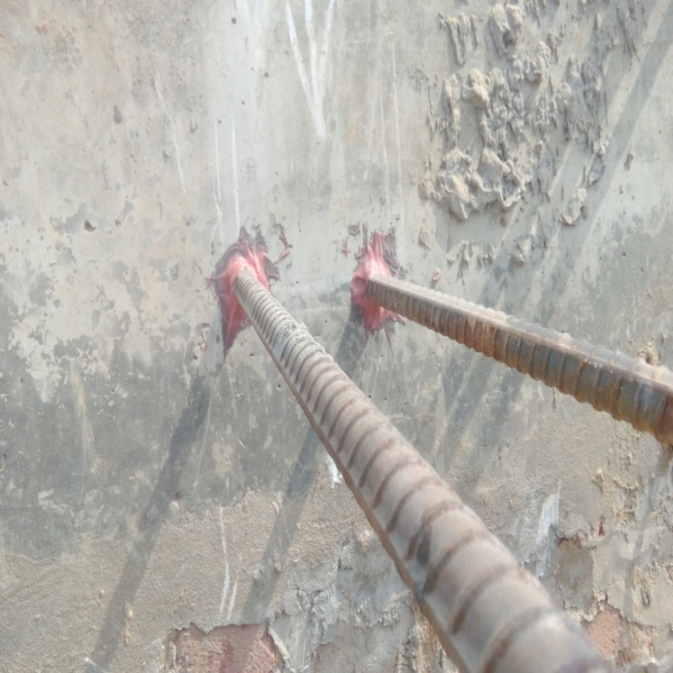
Connecting the New Pile cap with the existing plinth beams by new beams to transfer the load to the new piles
METHODOLOGY OF RETROFITTING

Slide 12
Addition Of Suspended Slab
METHODOLOGY OF RETROFITTING
Introducing new structural slab, integrated with plinth beams, columns and new pile cap.
This slab would behave as suspended slab as the filled soil is removed. (Gap between suspended slab and finish ground level is reducing the overburden load and may be used for services.).
Integrating suspended slab with plinth beam in such a way that it acts as a single entity.

Slide 13
ADDITIONAL Reinforcement FOR PLINTH BEAM
METHODOLOGY OF RETROFITTING
CONNECTING suspended slab WITH PLINTH BEAM AND COLUMNS

Slide 14
Reinforcement ready for suspended slab casting
METHODOLOGY OF RETROFITTING

Slide 15
Strengthening of GRADE BEAM, PLINTH BEAM AND COLUMNS:
METHODOLOGY OF RETROFITTING
Grade Beams
by Carbon Fibre wrapping.
Plinth Beams
by fixing the Carbon Laminate and by Carbon Fibre wrapping.
Columns
by Carbon Fibre wrapping

Slide 16
GRINDING OF GRADE BEAM AND PLINTH BEAM To smoothen the concrete surface
METHODOLOGY OF RETROFITTING
Plinth Beam
Grade Beam

Slide 17
APPLICATION OF POLYMER MODIFIED MORTAR (PMM) TO THE BOTTOM OF PLINTH BEAMS As a leveling course to make good the undulations in the bottom of beams.
METHODOLOGY OF RETROFITTING

Slide 18
GROUTING OF CRACKS WITH MONOPOL CHEMICAL To fill the cracks (Grouting pressure: 3-5 Kg/cm2)
METHODOLOGY OF RETROFITTING
Fixing of Nozzle
Monopole Chemical
Grouting Machine

Slide 19
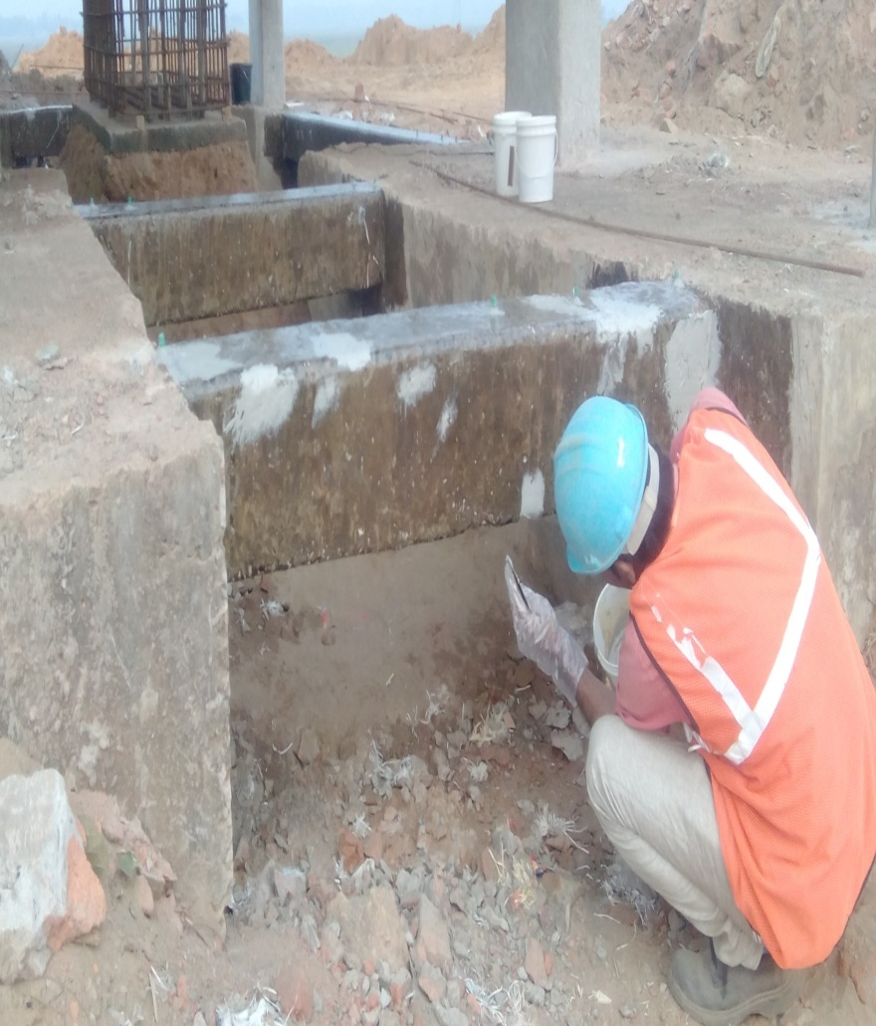
APPLICATION OF PRIMER COAT OVER THE BEAM SURFACE To fill the surface voids
METHODOLOGY OF RETROFITTING
APPLICATION OF PUTTY –
As leveling course
RESIN PRIMER APPLICATION
PUTTY APPLICATION

Slide 20
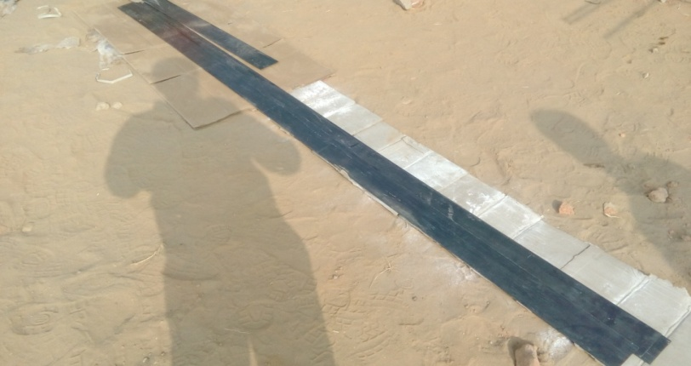
CARBON FIBRE LAMINATE :
METHODOLOGY OF RETROFITTING
Physical Properties:
Materials- Carbon-80%, Resin-20%,
Density-1.6 gm/cc
Laminate width-100 mm and Thickness-2.4 mm
Mechanical Properties:
Laminate Tensile Strength -1800 Mpa
Laminate Tensile Elastic Modulus-150 GPa

Slide 21
Fixing of carbon laminate to the plinth beams in 80% length
METHODOLOGY OF RETROFITTING
FIXING OF ANCHOR PLATE
To provide firm fixidity of Laminate with plinth beam bottom
Fixing of Laminate to the Plinth Beam bottom
Fixing of Anchor plate to Plinth beam

Slide 22
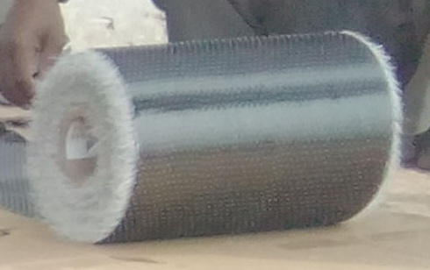
Carbon Fibre
METHODOLOGY OF RETROFITTING
Physical Properties:
Materials:
Carbon content -99%, Thermo glass yarn -1%
Carbon Fibre wrap width-500 mm
Carbon Fibre Thickness - 0.44 mm
Mechanical Properties:
Carbon Fibre Tensile Strength – 4100 Mpa
Carbon Fibre Tensile Modulus - 250 GPa

Slide 23
CARBON FIBRE WRAPPING OF THE GRADE BEAM, PLINTH BEAM AND COLUMN
METHODOLOGY OF RETROFITTING
Confines the concrete
Enhances compressive strength of concrete.
Improves shear strength of concrete.
Improves ductility of structural elements .
Arrests the crack propagation in the beams.

Slide 24
CARBON FIBRE WRAPPING
METHODOLOGY OF RETROFITTING

Slide 25
FIXING OF CARBON FIBRE ANCHOR To have intact bond between beam and carbon fibre (Spacing 300mm c/c)
METHODOLOGY OF RETROFITTING
Second coat of Epoxy over the carbon fiber wrapping To protect from weathering action
Carbon Fibre Anchor

Slide 26
CONCLUSIONS
Initially when construction was carried out, the condition of soil was poor and initial consolidation settlement caused distress.
Piling and filling of soil work were done simultaneously which resulted into negative skin friction.
Retrofitting of station building aimed at deriving the adequate lateral capacity for earthquake resistance and to strengthen for the applicable loads, forces and effects.

Slide 27
The creation of strong diaphragm by structural slab and beams along with additional Piles/ Pile Cap also helped in arresting differential settlement.
The retrofitting of station building includes the state of art techniques by using CFRP wrap, Carbon Fiber Anchors, Carbon Laminates etc, for strengthening Grade Beams, Columns, Plinth beams which makes the system very strong and durable.
Overall, following capacities were enhanced by doing retrofitting.
Shear capacity.
Flexural capacity of beam.
Load bearing capacity of Columns and Foundations.
Ductility and Seismic capacity.

Slide 28
THANK YOU

